Slide 1


Academic Writing

Slide 2
Think about how you communicate with
different types of people?

Slide 3
Do you use the same tone, words, and phrases to communicate with your friends as you do when you communicate with your parents or your teachers?

Slide 4
If you do communicate with everyone in the
same way throughout your life, you are likely
to have difficulties.

Slide 5
In every culture around the world, the way
people are expected to communicate with
friends, strangers, or people in authority over them differs.

Slide 6
Those who do not learn how to communicate in different ways to different people will have a hard time getting people to listen to and
understand what they have to say.

Slide 7
If you want people to hear what you have to say, it pays to learn how to communicate in different ways.

Slide 8
What is Academic Writing?
Academic writing is a method of written communication that is used extensively in educational and research field to convey the author's ideas or research.

Slide 9
What is Academic Writing?
It is a genre of writing that utilizes relatively complex language
effectively to persuade, inform and educate others, appropriate to a
discipline in an academic setting with the objective of advancing
knowledge of a subject.

Slide 10
Academic Writing
Academic writing is writing which communicates ideas,
information and research to the wider academic community.

Slide 11
People need to know what’s up.
(idiom/slang and contraction)
People need to be aware of the current issues.
(standard language)

Slide 12
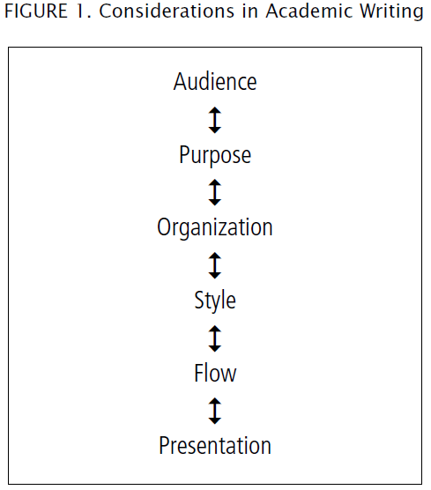

Slide 13
Knowing Your Audience
When we communicate with others, we need to consider with whom we are communicating. That person or persons are our audience.

Slide 14
Knowing Your Purpose
When we are communicating, we also need to
think about our purpose for communicating.
Sometimes we communicate to entertain
Sometimes we communicate to inform
Sometimes we communicate to persuade

Slide 15
Audience & Purpose
To determine whether we should communicate informally
or formally, we combine what we know about BOTH our
audience and the purpose for our communication. Then,
we pick the style that we think will be best for our audience to listen our ideas.

Slide 16
Audience and Purpose
Generally, communication with friends and relatives should
be informal. Communication with strangers, people in
authority, or co-workers is most often formal.
However, communication with a purpose to entertain is
usually informal regardless of the audience.

Slide 17
Features of Academic Writing
Structured
Evidenced
Critical
Precise
Balanced
Objective
Formal

Slide 18
Structured
Academic writing should have a clear structure.
For example,
An essay will have an introduction (including a thesis statement),
clear body paragraphs with topic sentences, and a conclusion.

Slide 19
Evidenced
Means, the opinions and arguments should be supported by
Facts,
Reasons,
Statistics, and
cited information from experts in the field.

Slide 20
Critical
Academic writing should be critical, rather than simply descriptive.
As an academic writer, you should not simply accept everything
you read as fact. You need to analyse and evaluate the information
you are writing about, in other words make judgements about it,
before you decide whether and how to integrate it into your own writing.

Slide 21
Precise
Academic writing should use clear and precise language.
This includes the use of subject specific vocabulary.
Such as:
Vector breeding conditions - Dengue fever
Hyper-endemic nature High levels of disease

Slide 22
Features of Academic Writing
Structured
Evidenced
Critical
Precise
Balanced
Objective
Formal

Slide 23
Types
There are two types of languages we use within single language ..
Formal
Informal

Slide 24
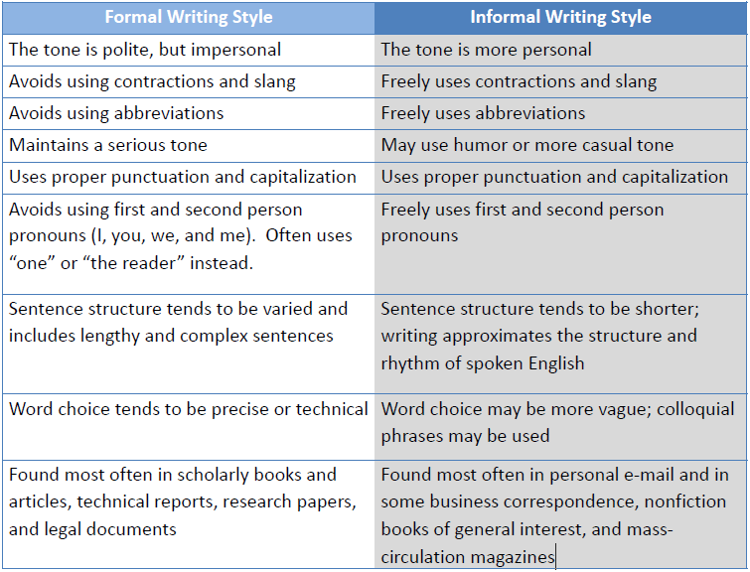

Slide 25
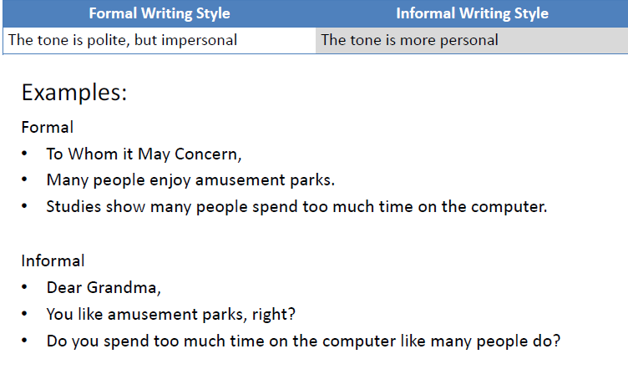

Slide 26
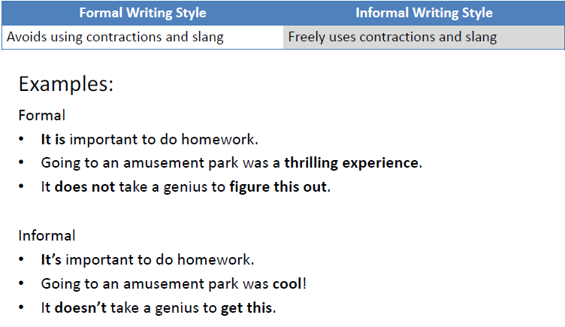

Slide 27
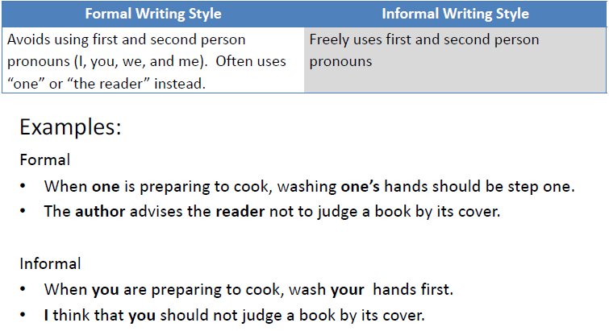

Slide 28
Use Impersonal Language (it/people/they): Instead of using first- and second-person pronouns “I” or “You”, use the third person. The third person is “he/she/it”. For example:
Too personal: I like how Shakespeare describes the scene.
Academic: Shakespeare describes the scene beautifully. (deleted personal pronoun “I”)
Too personal: Nowadays, we all have mobile phones. (We = first personal plural)
Academic: Nowadays, everyone has a mobile phone. (Everyone = third person)
Too personal: Marketers try to convince you to buy their products. (you = second-person singular)
Academic: Marketers try to convince people to buy their products. (people = third person perspective)

Slide 29
Suggest improvements to the following sentences to avoid use of “you” and “we”.
1. You can apply the same theory of learning to small children.
2. You can only do this after the initial preparation has been conducted.
3. The figures are accurate to within 1%, but you should note that local variations may apply.
4. In the second section of the report, we will consider the environmental consequences.

Slide 30
1. The same theory of learning can be applied
2. This can only be done
3. it should be noted that
4. The second section of the report will

Slide 31
Suggest alternatives to the following to avoid use of personal language.
In this essay I will discuss the main differences between the English and Scottish
legal systems.
2. I have divided my report into five sections.
3. I will conclude by proposing that all drugs should be legalized.
4. The opinion of the present author in this essay is that the importance of the
monarchy should be reduced.
5. In the third part of the essay, we will look at the reasons for public hysteria over
the SARS virus.
6. Although I am not an expert in the field, I have tried very hard to understand
the main ideas.

Slide 32
1. This essay will discuss
2. The report has been divided into five sections OR There are five sections in this report
3. The essay will conclude
4. The importance of the monarchy should be reduced because... (explain, with evidence)
5. The third part of the essay will examine / discuss / analyse... (choose the correct word to describe the content)
6. Remove this, just provide the evidence and your analysis

Slide 33
Use hedging (i.e. tentative language), such as 'possibly', 'probably', 'may', 'might', 'appears to', and 'seems to' to qualify statements. Avoid absolute statements and words such as 'always'.
✓ Education may reduce crime.
✓ It appears that education reduces crime.
✗ Education reduces crime.
✓ This is possibly caused by the effects of global warming.
✓ This may be caused by the effects of global warming.
✗ This is caused by the effects of global warming.
✓ Chinese students often make mistakes with tenses.
✗ Chinese students always make mistakes with tenses.

Slide 34
Eating fast food is bad and should be avoided.
He is guilty.
Computers are taking away our privacy.
Paper newspapers will disappear with in the next decade.
I am right.

Slide 35
Eating fast food is bad and should probably be avoided.
It is possible that he is guilty.
Computers are probably taking away our privacy.
It is likely that paper newspapers will disappear with in
the next decade.
I am probably right.

Slide 36
Use formal verbs instead of two-word verbs.
✓ increase, decrease, discuss, improve, deteriorate, continue, raise
✗ go up, go down, talk about, get better, get worse, go on, bring up

Slide 37
As you examine the health effects of ...
When examining the health effects of ...
I believe the health effects of ...
It is believed that the health effects of ...

Slide 38
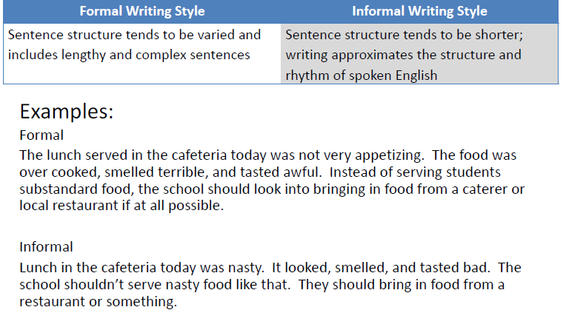

Slide 39
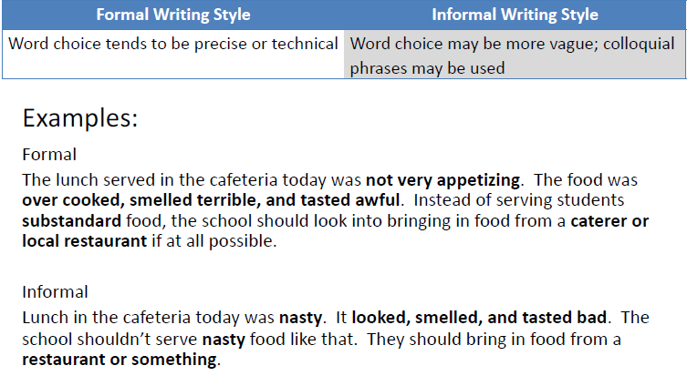

Slide 40
Which of the two alternatives in bold do you think is more appropriate in academic writing?
1. The government has made considerable/great progress in solving the problem.
2. We got/obtained excellent results in the experiment.
3. The results of lots of/numerous tests have been pretty good/encouraging.
4. A loss of jobs is one of the consequences/things that will happen if the process is automated.
5. The relationship between the management and workers is extremely/really important
6. Some suggestions springing up from/arising from the study will be presented.

Slide 41
Keys
1. considerable
2. obtained
3. numerous
4. consequences
5. extremely
6. arising from

Slide 42
Replace the contractions in the following sentences with full forms where necessary.
1. The results weren't very encouraging.
2. We'll have to conduct another experiment.
3. She's been all around the world.
4. It's the best solution to the problem.
5. Our questionnaire shows that teachers aren't paid what they're worth.
6. His response was, "A job's a job; if it doesn't pay enough, it's a lousy job'.
7. He'd rather announce the findings at the conference.
8. The department's approach didn't succeed.

Slide 43
Keys
1. were not
2. We will
3. She has
4. It is
5. are not / they are
6. No changes - this is a quotation
7. He would
8. did not

Slide 44
Replace the following phrasal verbs with a more formal single word.
1. The primary education system was set up throughout Ireland as early as 1831.
2. The decline was brought about by cheap imports.
3. The university is thinking about installing CCTV.
4. Sales are likely to drop off in the third quarter.
5. He went on speaking for over an hour.
6. The meeting was put off until December.
7. The cinema was pulled down ten years ago.
8. People have cut down on their consumption of beef.

Slide 45
1. Established
2. caused
3. considering
4. decline / fall
5. continued
6. postponed
7. demolished
8. reduced
If you have different answers - check their meaning carefully to see if they are a suitable replacement.

Slide 46
Make these statements more cautious.
1. Today, everyone uses credit cards for all their shopping.
2. Drinking wine is bad for you.
3. Global warming will have disastrous consequences for the whole world.
4. Teleworking leads to isolation.
5. Women are worse drivers than men.

Slide 47
There are many different ways to correct these sentences
1. Be specific, find evidence to identify how many people actually use them. Also, be specific about where/who - which city/country/continent or age/profession/etc.?
2. How much wine? Evidence needed. What harm does it cause? Evidence needed.
3. Avoid will unless you can prove that it is correct. Provide evidence and be careful/cautious with the language you use.
4. You can add can - can lead - but it is much better to provide evidence and explain why.
5. Provide evidence. Explain. Be specific. How is this measured? Accidents? Practical skills? Which women/men? Which age group/location/etc.? For example, young male drivers in the UK can be charged much more for car insurance because they are more likely to have accidents.

Slide 48
Rewrite the following in a more formal style.
1. The positive feedback made up for the problems we came across during the trials.
2. You can clearly see the differences between these two learning processes.
3. The subjects didn't have much difficulty with the task.
4. We found example after example of autonomous systems in lots of countries.

Slide 49
1. compensated for / experienced
2. The differences between these two learning processes can be clearly seen.
3. had little difficulty
4. numerous examples

Slide 50
Understanding Academic Writing
Notes:
Material Adapted from:
Academic Writing. (n.d.). Retrieved May 14, 2020, from University of Leeds https://library.leeds.ac.uk/info/14011/writing/106/academic_writing
Bailey, S. (2014). Academic Writing: A Handbook for International Students (Fourth ed.). London & NewYork: Routledge.
Features of Academic Writing. (n.d.). Retrieved May 13, 2020, from UEfAP.com: http://www.uefap.com/writing/feature/featfram.htm
Material Adapted from:
Academic Writing. (n.d.). Retrieved May 14, 2020, from University of Leeds https://library.leeds.ac.uk/info/14011/writing/106/academic_writing
Bailey, S. (2014). Academic Writing: A Handbook for International Students (Fourth ed.). London & NewYork: Routledge.
Features of Academic Writing. (n.d.). Retrieved May 13, 2020, from UEfAP.com: http://www.uefap.com/writing/feature/featfram.htm
Material Adapted from:
Academic Writing. (n.d.). Retrieved May 14, 2020, from University of Leeds https://library.leeds.ac.uk/info/14011/writing/106/academic_writing
Bailey, S. (2014). Academic Writing: A Handbook for International Students (Fourth ed.). London & NewYork: Routledge.
Features of Academic Writing. (n.d.). Retrieved May 13, 2020, from UEfAP.com: http://www.uefap.com/writing/feature/featfram.htm
Material Adapted from:
Academic Writing. (n.d.). Retrieved May 14, 2020, from University of Leeds https://library.leeds.ac.uk/info/14011/writing/106/academic_writing
Bailey, S. (2014). Academic Writing: A Handbook for International Students (Fourth ed.). London & NewYork: Routledge.
Features of Academic Writing. (n.d.). Retrieved May 13, 2020, from UEfAP.com: http://www.uefap.com/writing/feature/featfram.htm

Slide 51
Forms of Academic Writing
Research Articles
Reports
Notes
Essays
Dissertation
Thesis
Project
Conference Papers

Slide 52
Academic Writing Style
We use language effectively to persuade, inform and educate others, and in academic style though there is no set or standardized style of writing, but in general academic writing is precise, impersonal and
objective.

Slide 53
Guidelines for Academic Writing Style
Although there are no rules for academic style, yet certain guidelines may help students develop an appropriate style that is required. Following are some elements of writing that need to be considered:
Correct usage of vocabulary with no informal or impersonal style of writing should be followed; words such as ‘ok’, or phrases similar to ‘I believe…’ are inappropriate.
Emotive language must not be used.

Slide 54
Guidelines for Academic Writing Style
Idiomatic or colloquial vocabulary, use of slang words, jargon, abbreviations, or many clichés should be avoided.
Accuracy in choosing vocabulary is essential. Words and terms have very specific meanings and it is important that you use them correctly, both in meaning and grammatical use.
Word contractions (of verbs) should not be used such as don’t, hasn’t or mustn’t.

Slide 55
Guidelines for Academic Writing Style
Repetition of words should be avoided.
Appropriate sentence structure with correct grammar as well as
accurate use of tenses is a mandatory.
Use of the third-person rather than first-person perspective.

Slide 56
Guidelines for Academic Writing Style
In academic writing, facts and figures are given precisely
Citing sources accurately

Slide 57
I think that essay writing is an important skill for all of us students. Don’t you see how many marks are given for this? Lots of students agree that they are marooned if they can’t write a decent essay. In my opinion (as a struggling student), we should have lessons in essay writing from day one!!!
Formal, straightforward, clearly written, correct academic.
Informal, like spoken (colloquial) language, incorrect academic
Too formal, uses too many words, incorrect academic

Slide 58
I think that essay writing is an important skill for all of us students. Don’t you see how many marks are given for this? Lots of students agree that they are marooned if they can’t write a decent essay. In my opinion (as a struggling student), we should have lessons in essay writing from day one!!!
Formal, straightforward, clearly written, correct academic.
Informal, like spoken (colloquial) language, incorrect academic. Correct!
Too formal, uses too many words, incorrect academic.

Slide 59
It is in fact correct to say that academic essay writing is of utmost importance in the attainment of a university degree. A high proportion of marks are allocated to the compilation of essay assignments as part of a university course to the point where it could be the causation of terminating a degree program because of failure. There is somewhat of an obligation for universities in the provision of services to the student population to educate their students in the intricacies of essay writing early in their undergraduate first year.
Formal, straightforward, clearly written, correct academic style
Informal, like spoken (colloquial) language, incorrect academic style
Too formal, uses too many words, incorrect academic style

Slide 60
It is in fact correct to say that academic essay writing is of utmost importance in the attainment of a university degree. A high proportion of marks are allocated to the compilation of essay assignments as part of a university course to the point where it could be the causation of terminating a degree program because of failure. There is somewhat of an obligation for universities in the provision of services to the student population to educate their students in the intricacies of essay writing early in their undergraduate first year.
Formal, straightforward, clearly written, correct academic style
Informal, like spoken (colloquial) language, incorrect academic style
Too formal, uses too many words, incorrect academic style. Correct!

Slide 61
Essay writing is an important skill for tertiary students. Academic essays can attract a considerable proportion of assessment marks in most degree programs. Therefore, students may require a firm grounding in academic essay writing skills at the start of their first year to assist them to succeed in their university studies.
Formal, straightforward, clearly written, correct academic style
Informal, like spoken (colloquial) language, incorrect academic style
Too formal, uses too many words, incorrect academic style

Slide 62
Essay writing is an important skill for tertiary students. Academic essays can attract a considerable proportion of assessment marks in most degree programs. Therefore, students may require a firm grounding in academic essay writing skills at the start of their first year to assist them to succeed in their university studies.
Formal, straightforward, clearly written, correct academic style
Informal, like spoken (colloquial) language, incorrect academic style
Too formal, uses too many words, incorrect academic style

Slide 63
Identify the different types of informal language in the following paragraph.
Americans disagree whether the death penalty is a bad idea or not. Some people don’t think that the death penalty is humane, while many
conservatives believe that it’s fair punishment for killing someone, even if the murderer is under 18 years old.. I believe the death penalty is a
good way to stop kids from killing each other. Nobody would commit a crime. When you find out that guys you know have been fried for a
crime.

